Slide 1

Embedding Content: iFrame and Media Tags in HTML
HTML5 provides powerful tags for embedding diverse media, from images to external documents. The <img>, <iframe>, <video>, and <audio> tags are foundational for enhancing user experience with rich, dynamic content, crucial for modern web development and interactivity.

Slide 2

The <img> Tag: Displaying
Images
Purpose
Embeds an image directly into your web document,
making visual content an integral part of your design.
Essential Attributes
src: Defines the URL of the image, e.g., src="photo.jpg".
alt: Provides alternative text for accessibility
and SEO, e.g., alt="A vibrant landscape".
width, height: Sets intrinsic dimensions,
e.g., width="400", height="300".

Slide 3
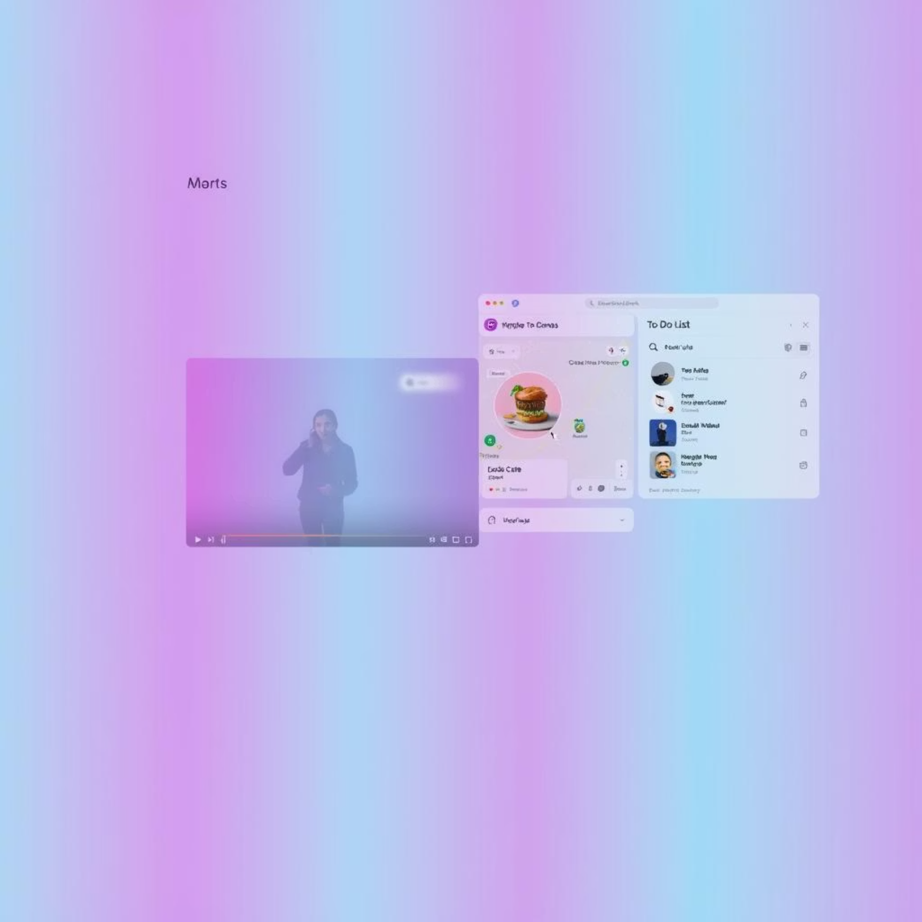
The <iframe> Tag: Embedding
Other Documents
The <iframe> tag allows you to embed another HTML document within the current one. This creates an independent browsing context, useful for integrating external content seamlessly into your page.
Essential Attributes
src: Specifies the URL of the document to embed, e.g., src="https://www.youtube.com/embed/dQw4w9WgXcQ".
width, height: Sets the dimensions of the iframe.
frameborder="0": (Deprecated) Removes the default border.
Use CSS for styling borders instead.
Common Use Cases
Embedding YouTube videos for media playback.
Integrating Google Maps for location services.
Displaying third-party widgets or applications.

Slide 4

The <video> Tag: Embedding
Video Content
The <video> tag provides a native way to embed video playback directly
into your HTML document, offering a rich multimedia experience without
requiring third-party plugins.
Essential Attributes
src: URL of the video file, e.g., src="clip.mp4".
controls: Displays browser's default video controls.
autoplay: Starts video automatically (often requires muted).
loop: Repeats the video.
muted: Mutes audio by default, useful with autoplay.
poster: Image to display before video loads.
Multiple Sources for Compatibility
Use the <source> tag within <video> for different video formats to
ensure broad browser compatibility:
<video controls>
<source src="video.mp4" type="video/mp4"> </video>

Slide 5


The <audio> Tag: Embedding Audio Content
Purpose
Essential Attributes
Integrates audio playback directly into your web page, perfect for podcasts, background music, or sound effects.
src: URL of the audio file.
controls: Displays default player controls.
autoplay: Plays automatically (often with muted).
loop: Repeats audio.
muted: Mutes audio by default.
<audio controls>
<source src="audio.mp3" type="audio/mpeg">
</audio>

